Slide 1

Creating AMD Dijits for ArcGIS API for JavaScript
Matt Driscoll @driskull github.com/driskull
https://github.com/driskull/arcgis-dijit-sample-js
Notes:
I work in Esri Technical marketing
I get to build cool demos using our software. Mostly using the ArcGIS JS API
Also get to help development by building widgets
Originally learned JS, then jQuery, now Dojo.
I built these widgets using Dojo’s AMD syntax.
I actually started writing the geocoder as original dojo legacy syntax and then converted it to AMD then wrote the directions widget starting with AMD.

Slide 2
Asynchronous Module Definition (AMD)
Fewer global variables
Plays nice and can be used with other AMD libraries
Improvements
Asynchronous loading
Dependency handling
Notes:
What is AMD?
Assigns Local variables instead of using global namespaces
Not all dojo code is available in AMD. Some dojox and dijits are not converted yet

Slide 3
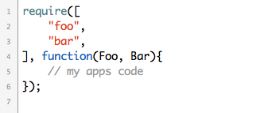
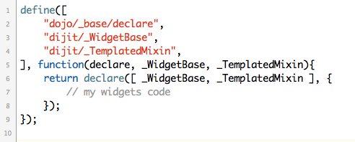
Dojo Loader
Require()
Define()
Notes:
Basically, what happens is, resources are loaded and assigned to a local variable passed into the define or require function as arguments.
Order matters! Small gripe
Nested require as conditional
domReady!

Slide 4
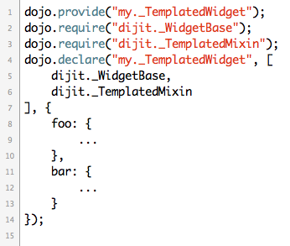
Legacy

Slide 5
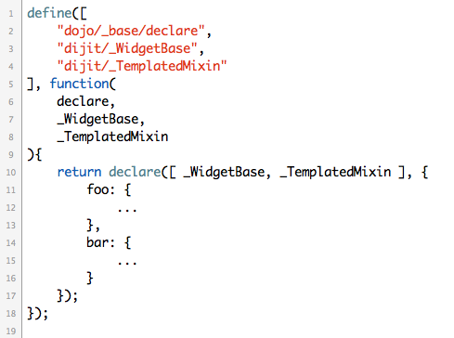
AMD

Slide 6
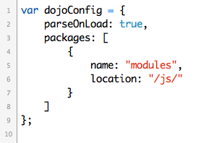
Dojo Config
Notes:
Add packages to load custom modules and dijits

Slide 7
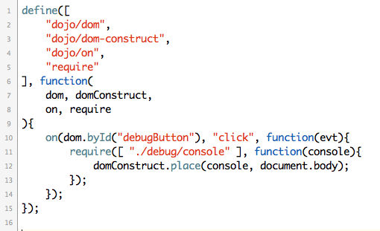
Conditional Require

Slide 8
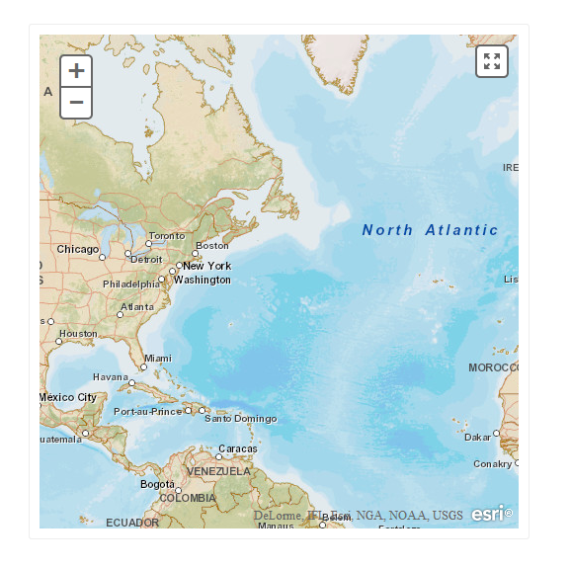
A Simple Dijit: HTML5 Fullscreen a Map
Notes:
We create a dijit that renders a button that toggles a map fullscreen using the browsers HTML5 fullscreen API.
The only thing we’re passing into the Dijit is a ArcGIS Map object.

Slide 9
Converting legacy code tips
Refer back to the latest Dojo API
Some functions deprecated or replaced
Use newer Dojo functions if available
Use new event handling with on()
Get/Set widget properties with .get() and .set()
watch() widget properties and call update functions

Slide 10
?

Slide 11
http://esriurl.com/survey
Offering ID: 361
https://github.com/driskull/arcgis-dijit-sample-js

